Slide 1
Unsupervised Lighting Reflectance Estimation
for Robot Monitoring under Poor Illuminance
Chen Xinyu The Hong Kong University of Science and Technology
Notes:
Good evening everyone. It's a pleasure to be here with you today. My name is XINYU .
Today, I will be presenting on the topic of low-light image enhancement for construction robot simultaneous localization and mapping.

Slide 2
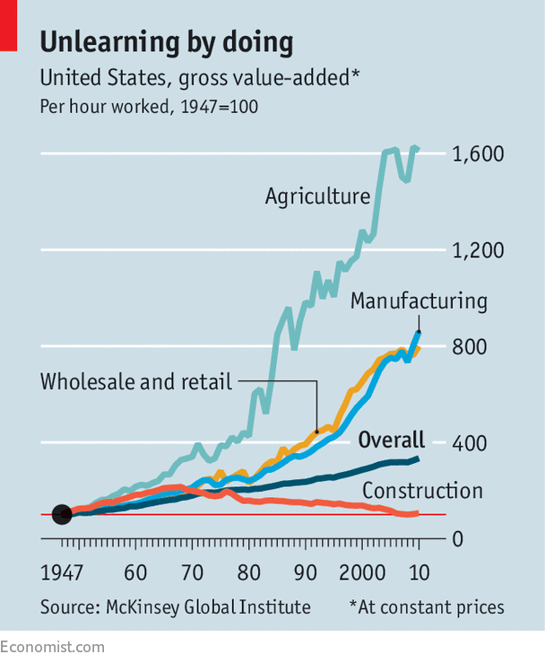
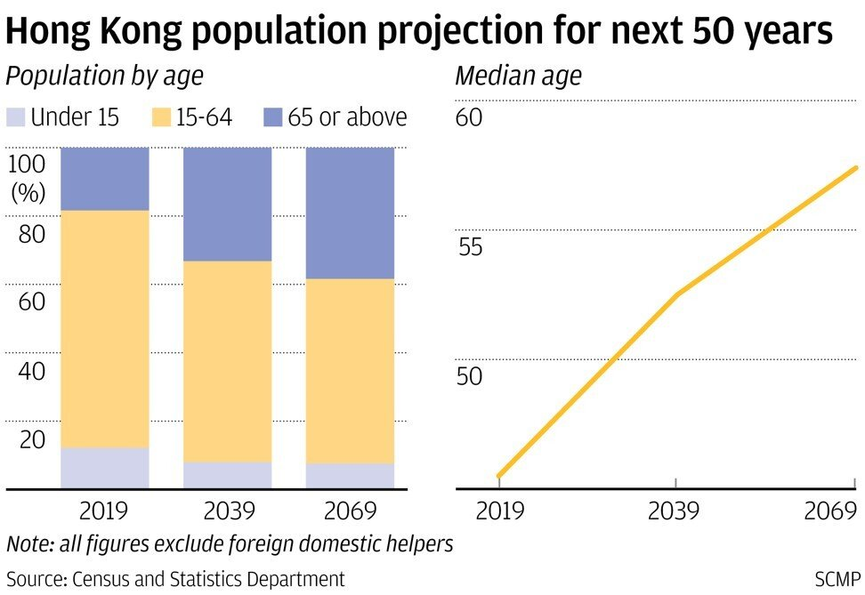
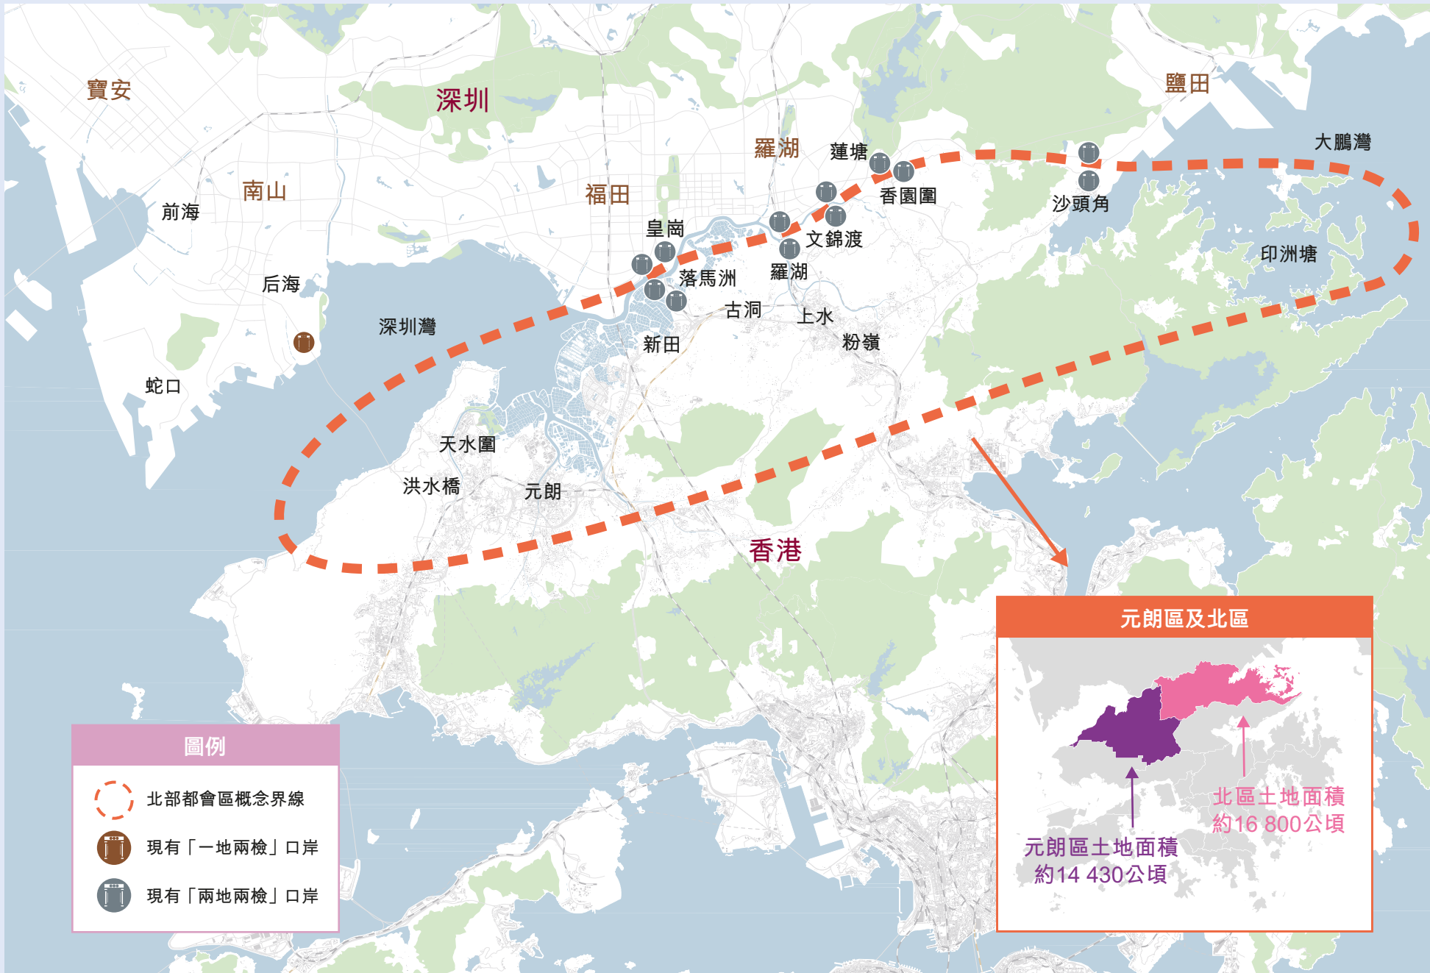
Introduction
Background
物体检测作为机器人的基本视觉任务，广泛服务于机器人的定位(SLAM)，自动驾驶和安全监控。
虽然深度学习技术引起了识别定位等任务突破性进展，计算机视觉技术在恶劣的光照条件下仍然不能发挥其全部的性能。
Low productivity
Aging workforce
Increasing market size
Notes:
With the progress of aging, the decline in productivity has become one of the issues in construction industry.
The shortage of human labor poses significant challenges for the construction industry.
Robots can help workers in dangerous environments to do repetitive work, which can finish construction tasks more efficiently and quickly.

Slide 3
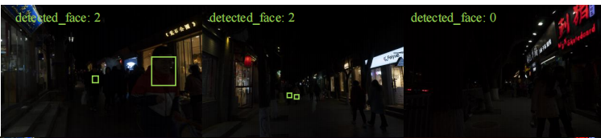
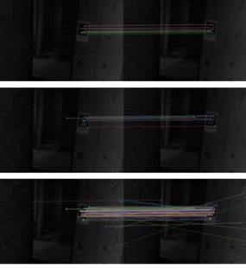
Introduction
Challenges
1.低光照下图像信息存在低对比度，噪声和纹理模糊等问题，图像的信息集中于低光域(被隐藏)，适用于正常光照下的算法不适用于低光照图像。
2.检测算法需要大量的训练数据才可以获得高正确率的模型，缺乏低光照数据集限制了低光照条件下的视觉检测应用。
Detection
Feature points extraction and matching
Notes:
There are two major challenges in low-light construction:
In complex low-light conditions, image information will be lost due to low illumination , low-contrast and noise.
SLAM algorithms have difficulty extracting feature points in low-light conditions and may cause significant positioning errors.
We want to recover visual information from low-light images and help robot locate and reducce errors

Slide 4
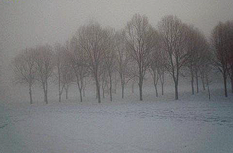
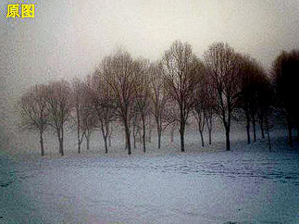
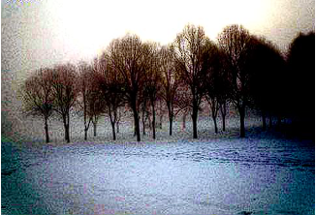
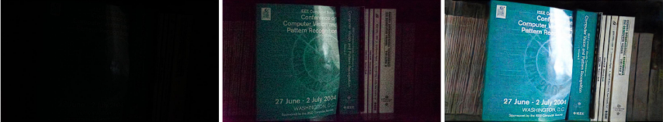
Existing solutions for enhancing low-light images:
(1)传统的方法需要在不同光照条件下调整参数。
(2)监督学习方法需要成对的训练图像,很难被收集。
(3)现有的增强算法缺乏对于图像信息特征的恢复。
Raw image Enhanced images with differenet parameters
Low-light image Long exposure images
Notes:
The existing enhancement methods have the following problems when used in V-SLAM in construction sites
(a) Manual enhancement method needs to adjust the parameters in different lighting conditions, and the enhancement effect is limited.
(2) Supervised learning methods require paired images for training, which can not always be collected

Slide 5
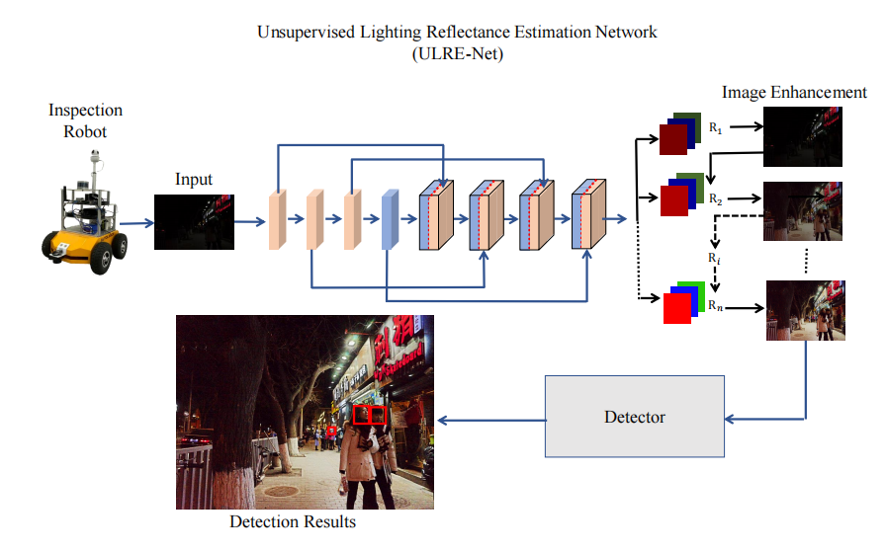

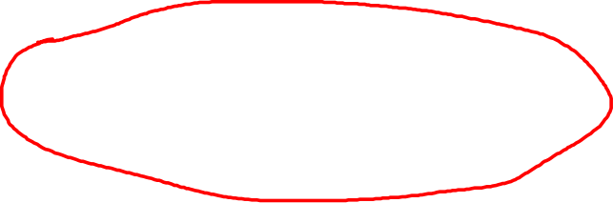


Methodology
ULRE-Net
我们提出了一个无监督的照明反射率估计网络(ULRE-Net)，利用增强的特征实现非均匀光照条件下的鲁棒性检测，用于机器人监控检测任务。
Notes:
URRN-Net consists of three parts: decomposition /ˌdiːˌkɒmpəˈzɪʃn/ part, reconstruction part, and localization part.
The decomposition part use CNN layers to extract lightness features and noise features from low-light images.
The reconstruction part uses reflectance maps to enhance the lightness and uses noise maps to reduce noise.
The enhanced frames are then input into an interframe lightness compensation system, which Balance the brightness of the before and after frames .
Finally, the enhanced frames are fed into ORB-SLAM3 [40] for localization.

Slide 6
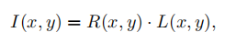
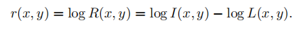
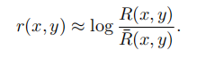
Methodology
ULRE-Net
根据Retinex理论，图像(I)可分解为光源照明(L)和场景反射率(R)。
两边取对数，我们得到相关的视网膜输出r(x, y)为
与高斯差分(DOG)函数类似，接受域和感知过程可以用中心/环绕方式建模，最终我们希望求得反射率模型为：
]
根据Retinex理论：亮度-颜色常数不变性质，与反射率相关的“真色”指导了无论不同照明条件下特征提取的估计。
所以我们使用深度学习模型通过迭代的方式求解反射率，在增强过程中使用反射率图来指导低光照图像的增强。
Notes:
URRN-Net consists of three parts: decomposition /ˌdiːˌkɒmpəˈzɪʃn/ part, reconstruction part, and localization part.
The decomposition part use CNN layers to extract lightness features and noise features from low-light images.
The reconstruction part uses reflectance maps to enhance the lightness and uses noise maps to reduce noise.
The enhanced frames are then input into an interframe lightness compensation system, which Balance the brightness of the before and after frames .
Finally, the enhanced frames are fed into ORB-SLAM3 [40] for localization.

Slide 7
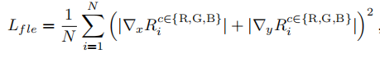
Methodology
Loss function
通过无监督学习方案得到近似的反射率图。具体地说，我们设计了一个反射平滑损失来估计反射图Ri：
其中N为迭代次数，∇为一级微分算子，故∇x和∇y分别为水平和垂直梯度操作。通过反射率近似实现所需的增强，将相应的特征馈送到下游检测任务中。
Notes:
It is challenging to capture different lighting-paired images of dynamic construction scene.
So we use unsupervised learning to overcome this problem.
we designed 5 loss functions : Information Difference Loss: Exposure Control Loss Illumination Smoothness Loss: Noise suppression loss Distorted Color Loss:

Slide 8
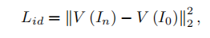
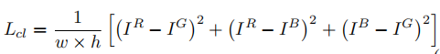
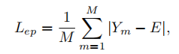
Methodology
Loss function
Information Difference Loss: 特征提取的质量在检测任务中起着至关重要的作用。因此，我们设计一个信息差分损失来度量增强后的图像与原始图像之间的差异
Color Constancy Loss: 由增强方法引起的潜在颜色偏差通过引入颜色恒常性损失来纠正，该损失通过桥接三个调整通道将增强的RGB通道限制在大致相同的水平
Exposure Control Loss: 增强图像被分割成16 × 16不重叠的局部区域，以获得平均强度Y。曝光良好的等级E定义为RGB空间中的灰度等级。评估平均强度Y与良好曝光水平E之间距离的曝光控制损失
Notes:
Noise suppression /səˈpreʃ(ə)n/ loss: During the process of low-light enhancement, image noise can be enlarged. The noise suppression loss function reduces noise influence. It is expressed as follows:
Distorted /dɪˈstɔːtɪd/ Color Loss: The color distorted loss keeps the enhanced RGB channels at the smae level by connecting the three adjusted channels

Slide 9
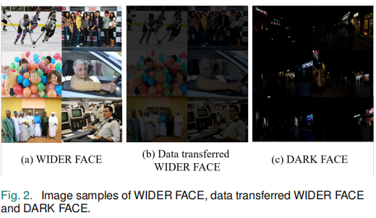
Methodology
Question: 缺乏低光照环境下的数据集用于检测模型的训练。
Solution: 我们使用数据迁移的方法，将大型公开的正常光照数据集（Wide Face 数据集）通过调整亮度对比度和添加高斯噪声，来模拟低光域下的图像(大量的低光照信息可以被模型学习)。
结论: 使用数据传输策略进行训练可以减轻这种差距的特征分布之间的正常和低光数据跨越各种物体和场景。这一策略支持了相应提高了检测模型的准确性和泛化程度。
Notes:
Question: The brightness differences between frames after enhancing the images in low-light construction sites sometimes is large. Large brightness difference causes positioning failure /ˈfeɪljə(r)/ .
Solution: We have designed an inter-frame compensation system to stabilize the transition between enhanced frames.
we use the sliding window to find the image that has a large brightness difference before and after, and then enhance or reduce the brightness of the image
简单的来说，我们使用滑动窗口找出亮度前后差异过大的图像，然后增强或者降低该图像亮度

Slide 10
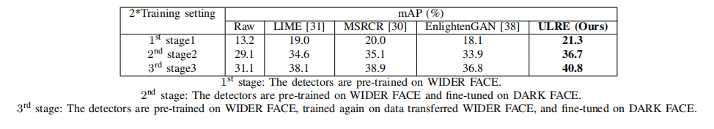
Methodology
第一阶段，检测模型仅在WIDER FACE数据集上进行预训练。2000
第二阶段，模型在WIDERFACE上进行预训练在DARK FACE的上进行fine-tuen。1000
第三阶段，WIDER FACE上预训练的，在Data transferred WIDERFACE fine-tune，最后在在DARK FACE进行微调，以获得最终的检测结果。 200
Notes:
Question: The brightness differences between frames after enhancing the images in low-light construction sites sometimes is large. Large brightness difference causes positioning failure /ˈfeɪljə(r)/ .
Solution: We have designed an inter-frame compensation system to stabilize the transition between enhanced frames.
we use the sliding window to find the image that has a large brightness difference before and after, and then enhance or reduce the brightness of the image
简单的来说，我们使用滑动窗口找出亮度前后差异过大的图像，然后增强或者降低该图像亮度

Slide 11
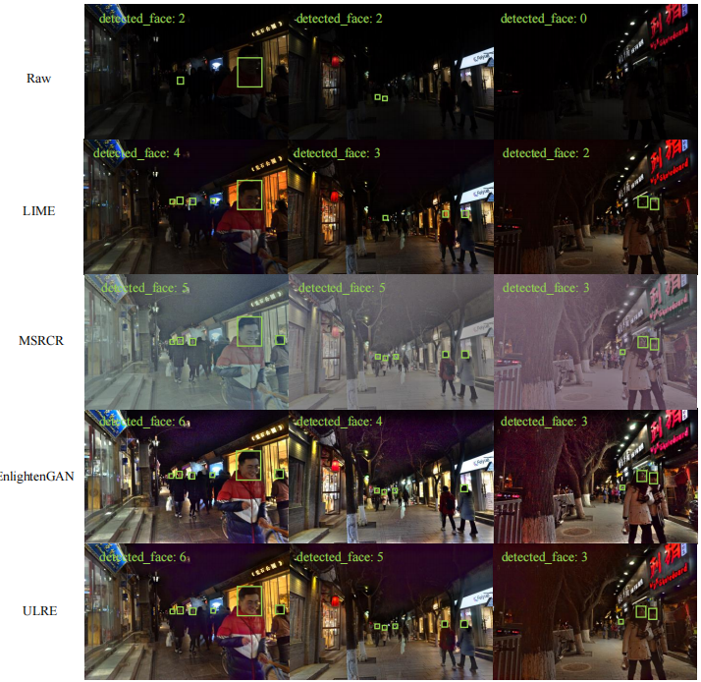
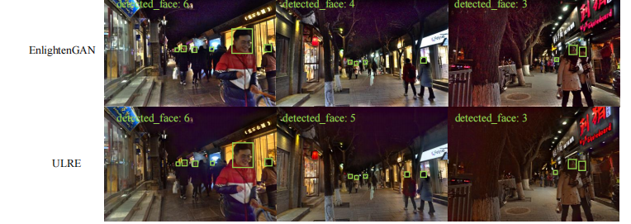
Experiments
Conclusion: ULRE-Net 可以在低光照环境中实现更多，更准确的人脸检测结果。
Notes:
we collect 2 dataset， one is used for training URRE-NET, This dataset includs 1,500 images and covered a wide range of exposure levels in both indoor and outdoor sites.
Other is used for test our method。This test V-SLAM dataset has 1,500 frame， it was collected from an indoor construction site in Foshan, China.

Slide 12
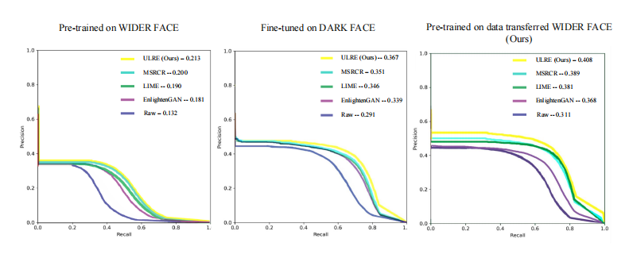
Experiments
现有的算法对:
Conclusion: ULRE-Net 在三种训练策略下都变现出了最高的准确率，使用数据迁移方法训练的模型都变现出了更好的结果。
Notes:
We use AprilTags to generate real track for collecting construction data.
We put Apriltags on the walls.
By computing the shape of an Apriltag in each frame , we can generate the 6D pose , as shown in Figure 5(a).
During camera motion, a series /ˈsɪəriːz/ of poses can be generated。 we can use poses to get the true track of the camera’s movement,

Slide 13
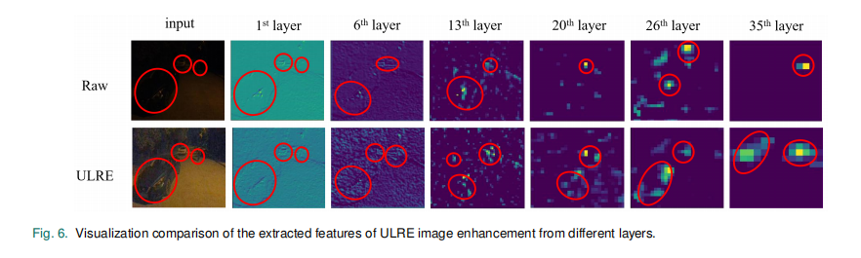
Experiments
VGG feature extract：
使用VGG进行特征提取，与原始图像相比，底部的ULRE增强图像识别出目标中更多有意义的特征，验证了所提出的ULRE增强方法在检测性能上进行了优化。
Notes:
we do Ablations /əˈbleɪʃn/ experiments of loss functions
we test the effects of each loss function as shown in figure .
without feature loss, There is not a significant decrease in image quality, but the positioning results show that the lack of feature loss (lfl) increases the positioning error.
without exposure control loss, the enhanced is dark and information is not recoved.
withour distorted /dɪsˈtɔrtɪd/ color loss ,The color is not right.
without illumination gradient loss (Ligl), the image show Image ghosting, the image is not clearly
without noise loss, the noise in lowight is enlarged.
We also compared the ability to locate each loss.
The experimental results show that each designed loss function contributesto the localization performance in its own way.

Slide 14
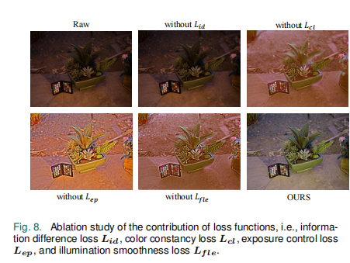
Experiments
Ablation experiments of loss functions
Conclusion: 信息损失函数都已各自的方式影响着图像增强的结果。
Notes:
we do Ablations /əˈbleɪʃn/ experiments of loss functions
we test the effects of each loss function as shown in figure .
without feature loss, There is not a significant decrease in image quality, but the positioning results show that the lack of feature loss (lfl) increases the positioning error.
without exposure control loss, the enhanced is dark and information is not recoved.
withour distorted /dɪsˈtɔrtɪd/ color loss ,The color is not right.
without illumination gradient loss (Ligl), the image show Image ghosting, the image is not clearly
without noise loss, the noise in lowight is enlarged.
We also compared the ability to locate each loss.
The experimental results show that each designed loss function contributesto the localization performance in its own way.

Slide 15
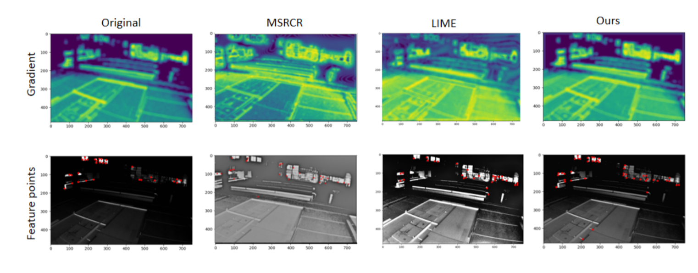
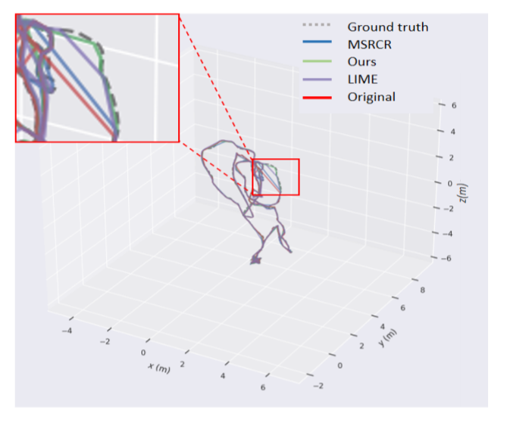
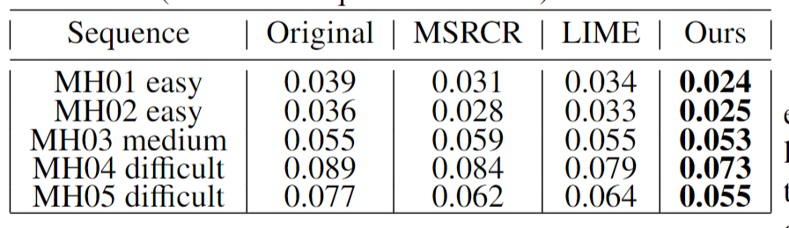
Experiments
Public dataset experiment
The gradient and feature point results of original, MSRCR, LIME and our method
3D pose graph
Conclusion: 所提出的方法可以稳定地提高亮度和对比度，获得更清晰的梯度信息和更多的特征点。它在 MAV测试数据集上显示了良好的性能。
Performance comparison in the EuRoC MH
datasets (Root mean square error in meter).
Notes:
we compare our method with other enhancement methods in SLAM feature point extraction and gradient /ˈɡreɪdiənt/ calculation, as shown in Figur.
It can be seen that the overexposure of MSRCR reduces the information gradient /ˈɡreɪdiənt/ and makes it difficult to extract feature points.
The LIME has local confusion /kənˈfjuːʒn/ and noise.
Our method can improve brightness and contrast clearly. It has clearer gradient information and extract more feature points.
we use MSRCR, LIME and our method to enhance MH datasets and use v-slam to locate.
using enhancement methods can reduce the error. Our method shows the best result in all test datasets.

Slide 16
Summary of research
受Retinex理论的启发，我们将反射图和噪声图作为深度学习的一致特征，然后估计反射图来指导照明的恢复。ULRE-Net使我们能够解决机器人在弱光条件下检测和定位的问题。
Unsupervised enhancement method
Better performance
Higher speed
我们使用无监督学习的ULRE-Net来解决机器人在弱光条件下检测和定位的问题。
我们在公共和现实世界的数据集中验证了我们的方法。检测结果从原始的13.2%提高到40.8%。
我们的方法可以实时运行(37 fps)，适合在低光环境中部署机器人。
Notes:
Inspired by the Retinex theory, we used the reflected map and noise mao to enhance lightness. We improve the low-light image and help V-SLAM to locate in low-light construction.
we Use Unsupervised method to improve low-light construction images.
We validate /ˈvælɪdeɪt/ our method in the public and real-world datasets. The results show that our method has better performance than existing methods.
Our method can be run in real-time (37 fps) on mobile computers and it is suitable for smallrobots or devices in low-light environments

Slide 17
Q and A

